Slide 1
Customer Retention Case Study

Slide 2

Analyzing the Dataset
Check the Column names with its datatypes.
Check the NULL values in columns along with the actual data in columns.
Relationship between different columns.
Handle the data Group wise in columns.
Most of the columns data is categorical , so We can check the unique values from every column and assign it one numerical value Or We can directly use the Label Encode.

Slide 3

Analyzing the Data
Check the Correlation between all the columns. Using this functionality we can check the relationship between different columns of dataset.

Slide 4
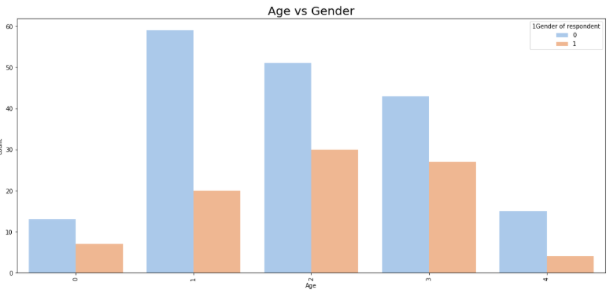
We can start with the Data Analysis of all the columns. Lets start with the Gender of customers with respect to Age of the customer
We can easily understand for all the age groups females are more active in online shopping

Slide 5
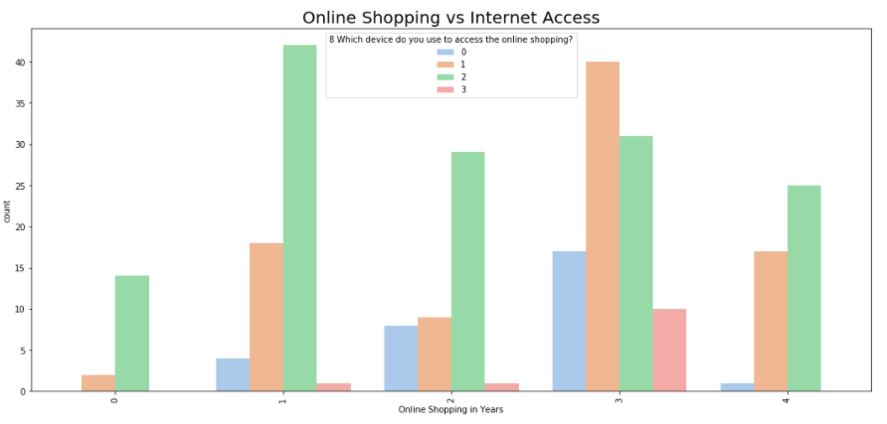
Devices Used to access for online shopping by the people having online shopping experience less than 1 to 5 and above.
Mostly SmartPhones are used for online Shopping.

Slide 6
Also we are checking devices used for online shopping vs web browser used to access website.
Gender wise How frequently customers are abandon (selecting an items and leaving without making payment) your shopping cart.
We are checking the age wise count of customers who are thinking online shopping gives them monetary benefit and discounts. To unhappy customers we can provide the shopping vouchers or discount vouchers to attract unhappy customers.
Check the Gender/Age wise Statistics of some columns
# Online purchase in the past 1 year
# How do you access the internet while shopping on-line
# Which device do you use to access the online shopping
# What browser do you run on your device to access the website
# Which channel did you follow to arrive at your favorite online store for the first time
# After first visit how do you reach the online retail store
# How much time do you explore the e- retail store before making a purchase decision
# What is your preferred payment Option
# How frequently do you abandon (selecting an items and leaving without making payment) your shopping cart
# Why did you abandon the “Bag”, “Shopping Cart”

Slide 7
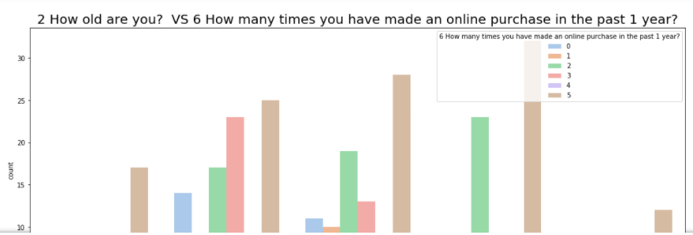
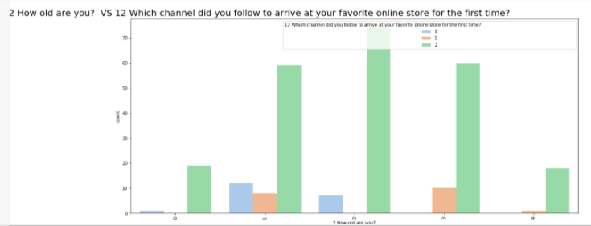
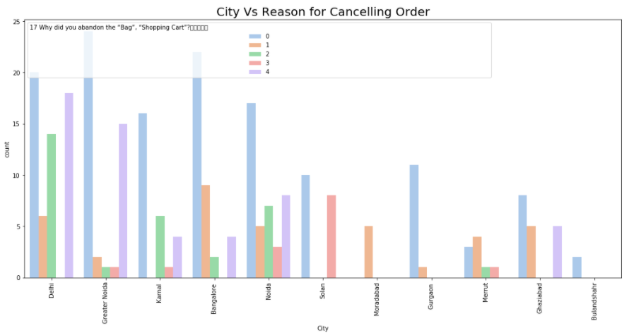

Slide 8
Check the Unhappy Customers
We are checking the happy and unhappy customers.
Accordingly we can improve our services to retain all of the customers.
To all the customers ,Return and replacement policy of the e-tailer is important for purchase decision for online shopping. Most of the customer (73%) are strongly agree with this policy.
Customer thinks money spent for Online Shopping products is value for money.
Customers thinking Shopping on the website gives them the sense of adventure.

Slide 9
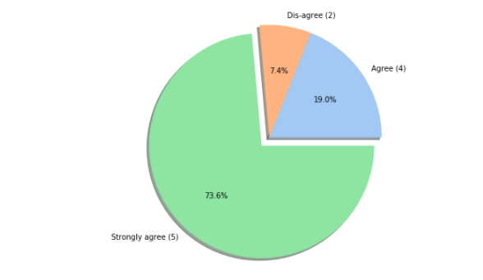
To all the customers ,Return and replacement policy of the e-tailer is important for purchase decision for online shopping. Most of the customer (73%) are strongly agree with this policy.

Slide 10
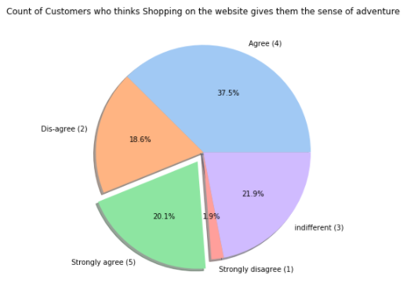
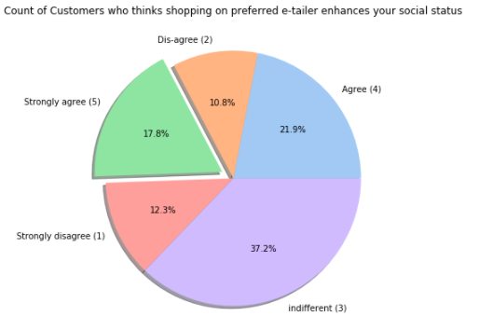
20% customers strongly agree for Shopping on the website gives you the sense of adventure
17.8% customers strongly agree Shopping on your preferred e-tailer enhances your social status.

Slide 11
Conclusion
I have created multiple graphs to check the relationship between the customers with respect to some observations.
Some customers are strongly disagree that online shopping help them to save the money. To that customers we can send the discount coupons.
City wise people are rejecting the online shopping because of trust issue, In this case we can try to improve delivery system and product quality.
Using this analysis we can try to retain our customers.

